Slide 1
A Basic Web Script
My example is at http://www.csit.parkland.edu/~kurban/csc220/
that prints your name

Slide 2
Requirements
Create file in python with a comment containing the academic honesty pledge as shown below. Add another, separate comment to the file containing your name
Write a python program that prints your name in a web script. It'll only be print commands along with the comments.
Turn in your file in using the dropbox link in cobra learning.
Put a link to your running file in the message area
# I honor Parkland’s core values by affirming that I have # followed all academic integrity guidelines for this work. # your name

Slide 3
The minimal code for the lab
# don't forget the pledge and your name up here
print("Content-type: text/html\n\n" ) print("My name is ----------")
put your name in here

Slide 4
Overview
Where a file is placed matters! Specifically for this class, everything needs to be under ~/public_html/cgi-bin/csc220
each project should be in a different folder, for instance you’ll have folders like ~/public_html/cgi-bin/csc220/lab1.
to create a folder under the current folder, the linux command is:
mkdir foldername
To show (print) the current working directory (folder) the command is:
pwd

Slide 5
More linux
To change the current working directory the command is:
cd
cd foldername
cd ..
to show (list) the files in the current folder, the linux command is:
ls
ls -l
to edit a file in the current folder, the linux command is:
pico filename
home directory
down to foldername
up to parent directory
use other editors if you wish

Slide 6
Connections
The directory
~/public_html/cgi-bin/csc220/lab1
is connected to the URL
http://www.csit.parkland.edu/~username/cgi-bin/csc220/lab1
For instance, the code I wrote for this lesson is at
http://www.csit.parkland.edu/~kurban/csc220
is in the directory
~kurban/public_html/csc220/

Slide 7
Copying files
~kurban means my home directory
You can copy my files with the command:
cp ~kurban/public_html/csc220/firstLab/* .
the * means all the files
the dot means the current directory
Where my files are

Slide 8
Apache-CGI programming
Someone on the internet will start our program through a link and the program should OUTPUT the http response that’s sent back to that person's browser. The browser will take the html from the http response and render it on the screen.
The executable need to be under the public_html/cgi-bin directory
The executable needs to have a .py extension
The executable needs to complete the http header with
print ("Content-type: text/html\n\n")

Slide 9
To Do List
Edit your program, don't forget the first line!
#!/usr/local/bin/python3.5
When you're done, make it executable
chmod 755 lab1.py
Open http://www.csit.parkland.edu/~username/cgi-bin/csc220/lab1 in a browser, click on lab1.py
Debug by returning to the editing command.
only need this command once

Slide 10
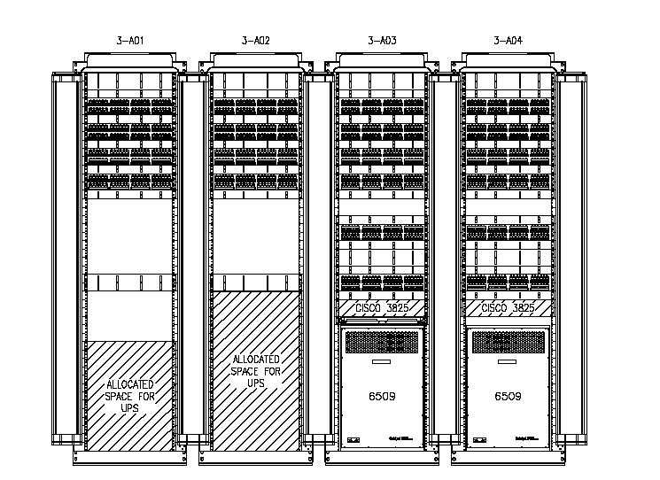


The Web
other servers
XML (RSS)
server
user-agent
(browser)
http request
dynamic server side program (executable)
internet
SQL
database
http response

Slide 11


How it works
You use putty.exe (windows) or ssh (apple) to connect to the remote server
source code
Someone running your program from somewhere on the web. (It might be you or me!)
your computer
You edit and compile source code.
internet
Someone runs the executable
www.csit.parkland.edu

Slide 12
what is http
http://www.tutorialspoint.com/http/http_messages.htm
https://en.wikibooks.org/wiki/Communication_Networks/HTTP_Protocol
Your code needs to output http for the browser to work with. Since http is text based, it's not hard.

Slide 13
Your program needs to be an http response. Below is what one looks like. You need to output (to cout) the parts 'provided by our program'.
200 OK
Content-type: text/html
Your name goes here
Provided by apache
blank line
Provided by your program
html content you provide

Slide 14
When an internal server error occurs:
run the program from the command line, this will check for permissions.
if it runs, check the http header carefully, make sure there is a blank line after 'Content-type'
ask Ken (giving him your username will help)

